Slide 1
Training Multi-Layer Neural Networks
Presented by:
Elizer Ponio Jr.
Department of Computer Science
College of Computing and Information Technologies

Slide 2
















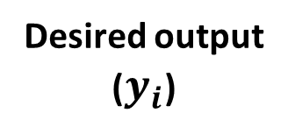



Desired output ($y_{i}$)
$$I_{1}$$
$$y_{0}$$
$$w_{11}$$
$$h_{1}$$
$$O_{1}$$
0.00
$$w_{41}$$
$$w_{12}$$
$$I_{2}$$
$$w_{42}$$
$$w_{21}$$
$$h_{2}$$
$$O_{2}$$
$$y_{1}$$
$$w_{22}$$
$$w_{51}$$
1.00
$$w_{31}$$
$$w_{52}$$
$$I_{3}$$
$$w_{32}$$
Weights = $w_{11}$, $w_{12}$, $w_{21}$, $w_{22},w_{31},w_{32},w_{41},w_{42},w_{51},w_{52}$

Slide 3











































$$w_{11}$$
$$I_{1}$$
$$w_{21}$$
$$I_{2}$$
$$w_{31}$$
$$I_{3}$$
$$w_{12}$$
$$I_{1}$$
$$w_{22}$$
$$I_{2}$$
$$w_{32}$$
$$I_{3}$$
$$I_{1}$$
$$w_{11}$$
$$h_{1}$$
$$O_{1}$$
$$a_{1}$$
$$a_{2}$$
$$w_{41}$$
$$w_{12}$$
$$I_{2}$$
$$w_{42}$$
$$w_{21}$$
$$w_{41}$$
$$w_{51}$$
$$w_{42}$$
$$w_{52}$$
$$h_{2}$$
$$O_{2}$$
$$h_{1}$$
$$h_{2}$$
$$w_{22}$$
$$w_{51}$$
$$w_{31}$$
$$w_{52}$$
$$a_{3}$$
$$a_{4}$$
$$I_{3}$$
$$w_{32}$$
$$O_{1}$$
$$y$$
$$O_{2}$$
$$C_{0}$$

Slide 4

























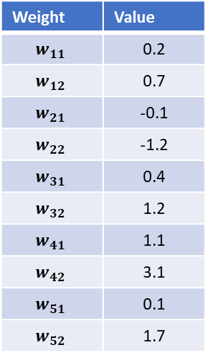







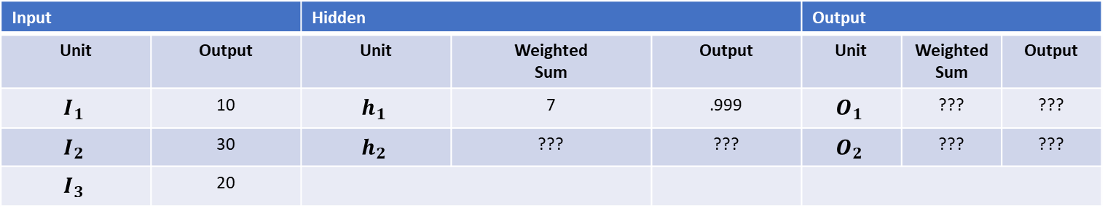
Weight | Value
$$w_{11}$$ | 0.2
$$w_{12}$$ | 0.7
$$w_{21}$$ | -0.1
$$w_{22}$$ | -1.2
$$w_{31}$$ | 0.4
$$w_{32}$$ | 1.2
$$w_{41}$$ | 1.1
$$w_{42}$$ | 3.1
$$w_{51}$$ | 0.1
$$w_{52}$$ | 1.7
Input |  | Hidden |  |  | Output
Unit | Output | Unit | Weighted Sum | Output | Unit | Weighted Sum | Output
$$I_{1}$$ | 10 | $$h_{1}$$ | 7 | .999 | $$O_{1}$$ | ??? | ???
$$I_{2}$$ | 30 | $$h_{2}$$ | ??? | ??? | $$O_{2}$$ | ??? | ???
$$I_{3}$$ | 20
$$w_{11}$$
$$I_{1}$$
$$w_{21}$$
$$I_{2}$$
$$w_{31}$$
$$I_{3}$$
$$w_{12}$$
$$I_{1}$$
$$w_{22}$$
$$I_{2}$$
$$w_{32}$$
$$I_{3}$$
$$a_{1}$$
$$a_{2}$$
$a_{1}$ = $w_{11}$ $I_{1}$ + $w_{21}$ $I_{2}$ + $w_{31}$ $I_{3 }$
$$a_{1} = (0.2 ∗ 10) + (−0.1 ∗ 30) + (0.4 ∗ 20)$$
$$w_{41}$$
$$w_{51}$$
$$w_{42}$$
$$w_{52}$$
$$h_{1}$$
$$h_{2}$$
$$a_{1} = 2 −3 + 8 = 7$$
$$a_{1} = 7$$
$$a_{3}$$
$$a_{4}$$
$$h_{1}\text{ =} σ (a_{1})$$
$$O_{1}$$
$$y$$
$$O_{2}$$
$$h_{1}\text{ = }\frac{1}{1+ e^{{−a}_{1}}} \text{=}\frac{1}{1+\text{e}\text{−7}}\text{=}\frac{1}{1+\text{+0.000912}}$$
$$C_{0}$$
$$h_{1} \text{=} \text{= }\text{0.999}$$

Slide 5





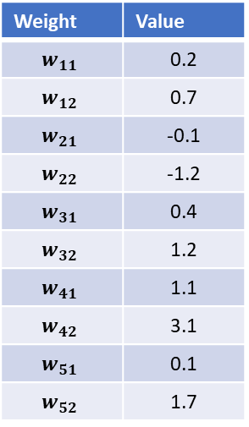






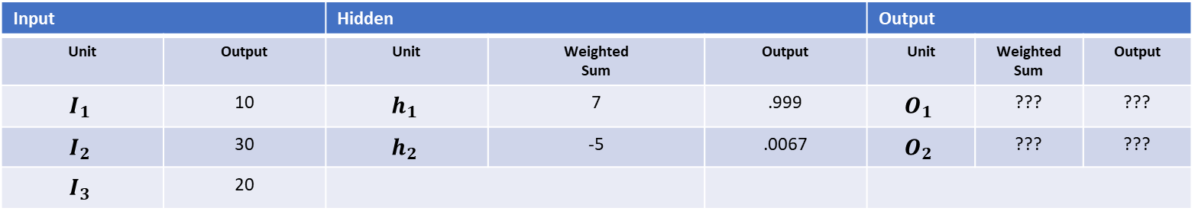
Weight | Value
$$w_{11}$$ | 0.2
$$w_{12}$$ | 0.7
$$w_{21}$$ | -0.1
$$w_{22}$$ | -1.2
$$w_{31}$$ | 0.4
$$w_{32}$$ | 1.2
$$w_{41}$$ | 1.1
$$w_{42}$$ | 3.1
$$w_{51}$$ | 0.1
$$w_{52}$$ | 1.7
Input |  | Hidden |  |  | Output
Unit | Output | Unit | Weighted Sum | Output | Unit | Weighted Sum | Output
$$I_{1}$$ | 10 | $$h_{1}$$ | 7 | .999 | $$O_{1}$$ | ??? | ???
$$I_{2}$$ | 30 | $$h_{2}$$ | -5 | .0067 | $$O_{2}$$ | ??? | ???
$$I_{3}$$ | 20
$$w_{11}$$
$$I_{1}$$
$$w_{21}$$
$$I_{2}$$
$$w_{31}$$
$$I_{3}$$
$$w_{12}$$
$$I_{1}$$
$$w_{22}$$
$$I_{2}$$
$$w_{32}$$
$$I_{3}$$
$$a_{1}$$
$$a_{2}$$
$a_{2}$ = $w_{12}$ $I_{1}$ + $w_{22}$ $I_{2}$ + $w_{32}$ $I_{3}$
$$a_{2}\text{ = (0.7 ∗ 10) + (−1.2 ∗ 30) + (1.2 ∗ 20) }$$
$$w_{41}$$
$$w_{51}$$
$$h_{1}$$
$$h_{2}$$
$$w_{42}$$
$$w_{52}$$
$$a_{2}\text{ =} \text{7 − 36 + 24 }$$
$$a_{2}= \text{−5}$$
$$a_{3}$$
$$a_{4}$$
$$h_{2}\text{ =} σ (a_{2})$$
$$O_{1}$$
$$y$$
$$O_{2}$$
$$h_{2}\text{ = }\frac{1}{1+ e^{{−a}_{2}}} \text{=}\frac{1}{1+\text{e}5}\text{=}\frac{1}{1\text{+}\text{148.4}}$$
$$C_{0}$$
$$h_{2}\text{ =} \text{0.0067}$$

Slide 6
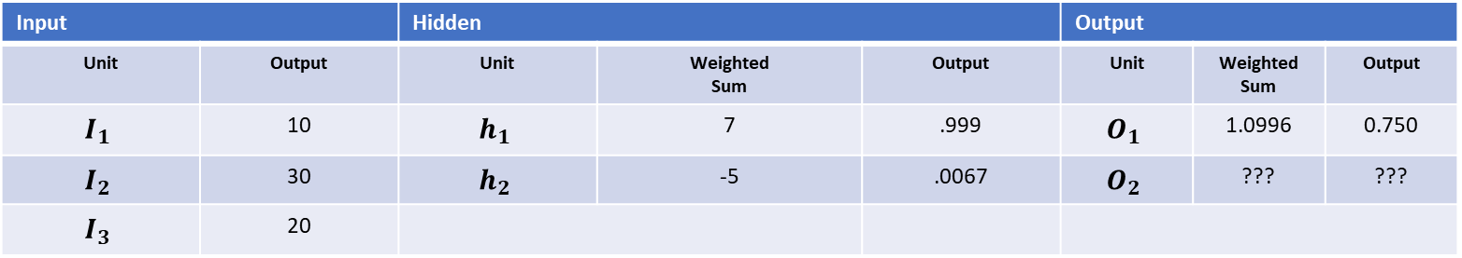








Weight | Value
$$w_{11}$$ | 0.2
$$w_{12}$$ | 0.7
$$w_{21}$$ | -0.1
$$w_{22}$$ | -1.2
$$w_{31}$$ | 0.4
$$w_{32}$$ | 1.2
$$w_{41}$$ | 1.1
$$w_{42}$$ | 3.1
$$w_{51}$$ | 0.1
$$w_{52}$$ | 1.7
Input |  | Hidden |  |  | Output
Unit | Output | Unit | Weighted Sum | Output | Unit | Weighted Sum | Output
$$I_{1}$$ | 10 | $$h_{1}$$ | 7 | .999 | $$O_{1}$$ | 1.0996 | 0.750
$$I_{2}$$ | 30 | $$h_{2}$$ | -5 | .0067 | $$O_{2}$$ | ??? | ???
$$I_{3}$$ | 20
$$w_{11}$$
$$I_{1}$$
$$w_{21}$$
$$I_{2}$$
$$w_{31}$$
$$I_{3}$$
$$w_{12}$$
$$I_{1}$$
$$w_{22}$$
$$I_{2}$$
$$w_{32}$$
$$I_{3}$$
$$a_{1}$$
$$a_{2}$$
$a_{3}$ = $w_{41} h_{1}+w_{51 }h_{2}$
$a_{3}$= (1.1) * (0.999) + (0.1*0.0067)
$$w_{41}$$
$$w_{51}$$
$$w_{42}$$
$$w_{52}$$
$$h_{1}$$
$$h_{2}$$
$a_{3}$= 1.0996
$$a_{3}$$
$$a_{4}$$
$$O_{1}\text{ =} σ (a_{3})$$
$$O_{1} \text{= }\frac{1}{1+ e^{{−a}_{3}}} \text{=}\frac{1}{1+e^{−1.0996}}\text{=}\frac{1}{1\text{+}0.333}$$
$$O_{1}$$
$$y$$
$$O_{2}$$
$$O_{1} \text{=} \text{0.750}$$
$$C_{0}$$

Slide 7
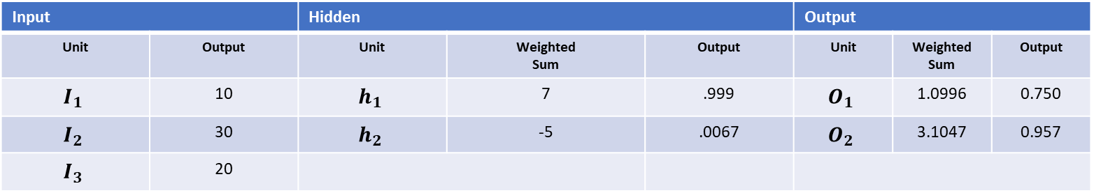










Weight | Value
$$w_{11}$$ | 0.2
$$w_{12}$$ | 0.7
$$w_{21}$$ | -0.1
$$w_{22}$$ | -1.2
$$w_{31}$$ | 0.4
$$w_{32}$$ | 1.2
$$w_{41}$$ | 1.1
$$w_{42}$$ | 3.1
$$w_{51}$$ | 0.1
$$w_{52}$$ | 1.7
Input |  | Hidden |  |  | Output
Unit | Output | Unit | Weighted Sum | Output | Unit | Weighted Sum | Output
$$I_{1}$$ | 10 | $$h_{1}$$ | 7 | .999 | $$O_{1}$$ | 1.0996 | 0.750
$$I_{2}$$ | 30 | $$h_{2}$$ | -5 | .0067 | $$O_{2}$$ | 3.1047 | 0.957
$$I_{3}$$ | 20
$$w_{11}$$
$$I_{1}$$
$$w_{21}$$
$$I_{2}$$
$$w_{31}$$
$$I_{3}$$
$$w_{12}$$
$$I_{1}$$
$$w_{22}$$
$$I_{2}$$
$$w_{32}$$
$$I_{3}$$
$$a_{1}$$
$$a_{2}$$
$a_{4}$ = $w_{42} h_{1}+w_{52 }h_{2}$
$a_{4}$= (3.1) * (0.999) + (1.7) * (0.0067)
$$w_{41}$$
$$w_{51}$$
$$w_{42}$$
$$w_{52}$$
$$h_{1}$$
$$h_{2}$$
$a_{4}$= 3.1047
$$a_{3}$$
$$a_{4}$$
$$O_{2}\text{ =} σ (a_{4})$$
$$O_{2} \text{= }\frac{1}{1+ e^{{−a}_{4}}} \text{=}\frac{1}{1+e^{−3.1047}}\text{=}\frac{1}{1\text{+}0.045}$$
$$O_{1}$$
$$y$$
$$O_{2}$$
$$O_{2} \text{=} \text{0.957}$$
$$C_{0}$$

Slide 8

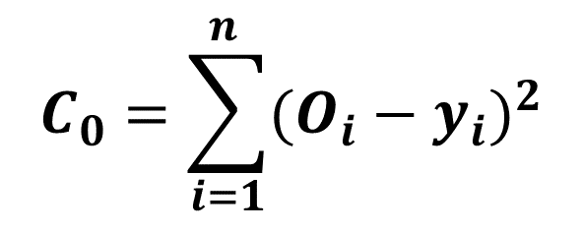
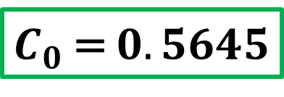

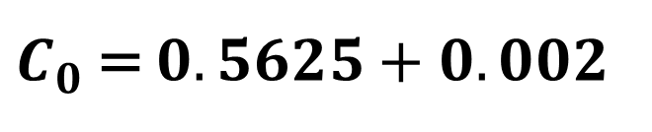

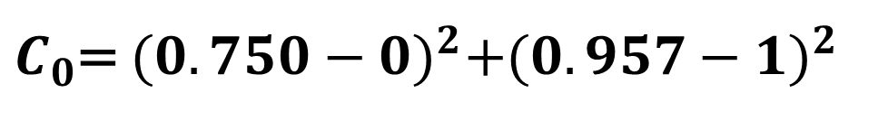

Input |  | Hidden |  |  | Output
Unit | Output | Unit | Weighted Sum | Output | Unit | Weighted Sum | Output
$$I_{1}$$ | 10 | $$h_{1}$$ | 7 | .999 | $$O_{1}$$ | 1.0996 | 0.750
$$I_{2}$$ | 30 | $$h_{2}$$ | -5 | .0067 | $$O_{2}$$ | 3.1047 | 0.957
$$I_{3}$$ | 20
$$C_{0}=\sum_{i=1}^{n }{{(O_{i}−y_{i})}^{2}}$$
$$w_{11}$$
$$I_{1}$$
$$w_{21}$$
$$I_{2}$$
$$w_{31}$$
$$I_{3}$$
$$w_{12}$$
$$I_{1}$$
$$w_{22}$$
$$I_{2}$$
$$w_{32}$$
$$I_{3}$$
$$a_{1}$$
$$a_{2}$$
$C_{0}=$ ${(O_{1}−y_{0} )}^{2}+{(O_{2}−y_{1})}^{2}$
$$w_{41}$$
$$w_{51}$$
$$h_{1}$$
$$h_{2}$$
$$w_{42}$$
$$w_{52}$$
$C_{0}$= ${(0.750−0)}^{2}+{(0.957−1)}^{2}$
$$a_{3}$$
$$a_{4}$$
$C_{0}$= $0.5625+0.002$
$$O_{1}$$
$$y$$
$$O_{2}$$
$C_{0}$= $0.5645$
$$C_{0}$$

Slide 9










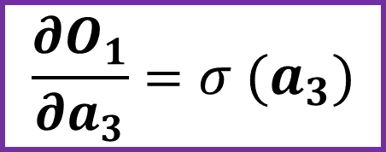


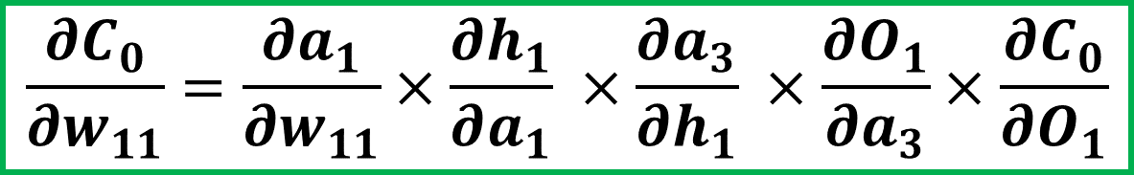



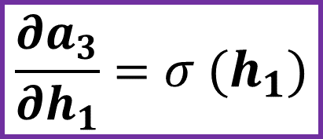






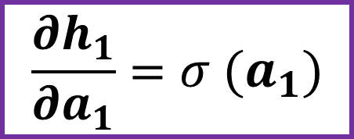





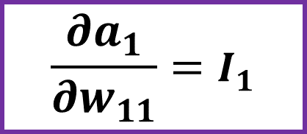

Chain Rule
$$\frac{∂C_{0}}{∂w_{11}}=\frac{∂a_{1}}{∂w_{11}}×\frac{∂h_{1}}{∂a_{1}} ×\frac{∂a_{3}}{∂h_{1}} ×\frac{∂O_{1}}{∂a_{3}}×\frac{∂C_{0}}{∂O_{1}}$$
$$w_{11}$$
$$I_{1}$$
$$w_{21}$$
$$I_{2}$$
$$w_{31}$$
$$I_{3}$$
$$w_{12}$$
$$I_{1}$$
$$w_{22}$$
$$I_{2}$$
$$w_{32}$$
$$I_{3}$$
$$a_{1}$$
$$a_{2}$$
$$\frac{∂a_{1}}{∂w_{11}}=I_{1}$$
$$\frac{∂h_{1}}{∂a_{1}}=σ (a_{1})$$
$$w_{41}$$
$$w_{51}$$
$$h_{1}$$
$$h_{2}$$
$$w_{42}$$
$$w_{52}$$
$$a_{3}$$
$$a_{4}$$
$$\frac{∂a_{3}}{∂h_{1}}=σ (h_{1})$$
$$\frac{∂O_{1}}{∂a_{3}}=σ (a_{3})$$
$$O_{1}$$
$$y$$
$$O_{2}$$
$$C_{0}$$
$$\frac{∂C_{0}}{∂O_{1}}=2(O_{1} −y_{0})$$

